Slide 1
Apache Spark Architecture

Slide 2
Apache Spark Architecture
Worker Node 1
Executor
Driver Program
Task
Task
Cluster Manager
Spark Context
Worker Node 2
Executor
Task
Task
https://spark.apache.org/docs/latest/cluster-overview.html

Slide 3
What is PySpark

Slide 4
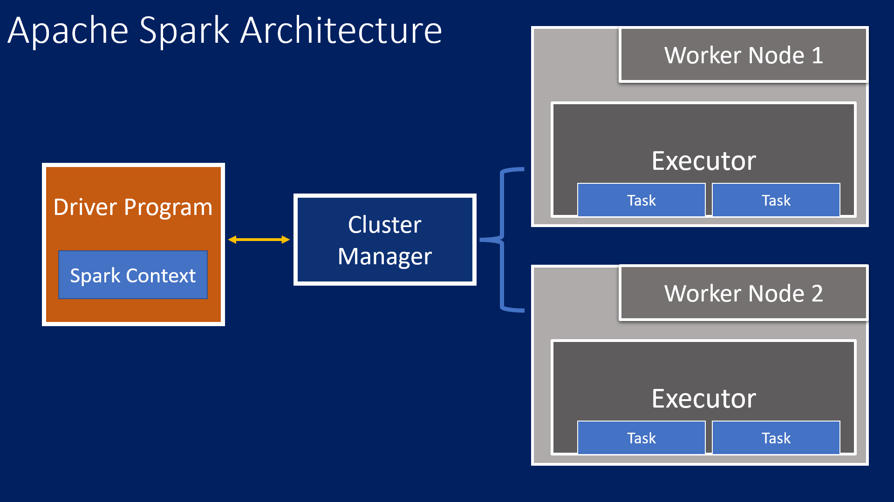
What is PySpark?
Python + Spark = PySpark
Python API for Apache Spark

Slide 5
Open Data Storage – Parquet

Slide 6
Databricks Architecture

Slide 7
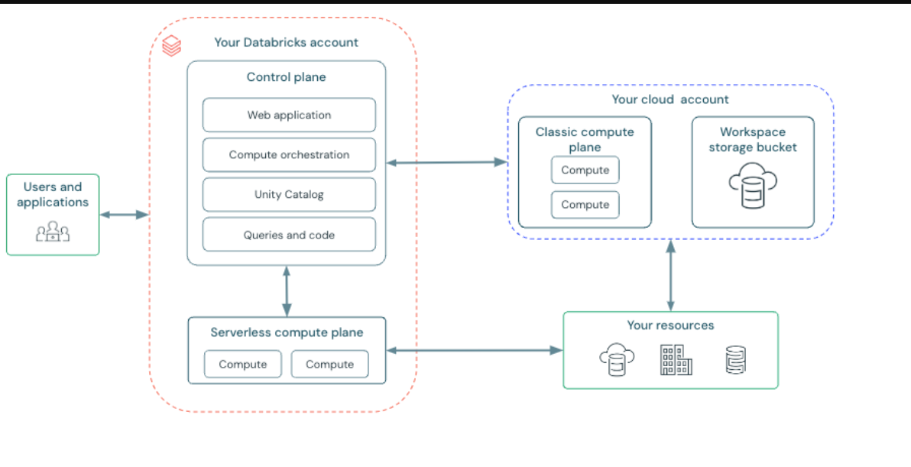
https://docs.databricks.com/aws/en/assets/images/architecture-c2c83d23e2f7870f30137e97aaadea0b.png

Slide 8
Medallion Architecture

Slide 9
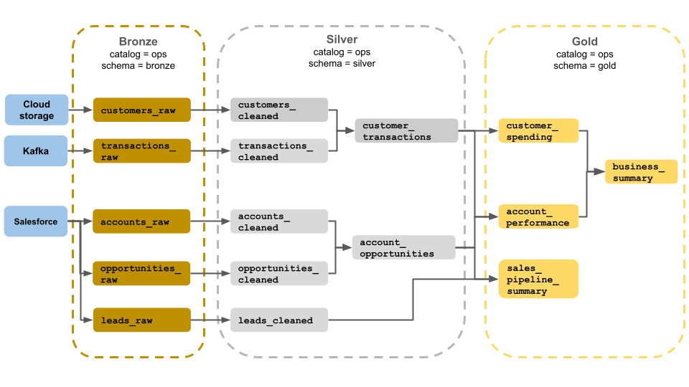

Slide 10
Performance Tuning

Slide 11
Optimizing Spark Configuration
Executor and Memory Tuning:
  Adjust executor memory and cores to optimize parallelism.
Example:
```python
  spark.conf.set("spark.executor.memory", "8g")
  spark.conf.set("spark.executor.cores", "4")
```

Slide 12
Dynamic Allocation:
Dynamic Allocation:
  Enable dynamic allocation for scaling executors based on workload.
Example:
```python
spark.conf.set("spark.dynamicAllocation.enabled", "true")
```

Slide 13
Shuffle Partitions:
Shuffle Partitions:
  Tune the number of shuffle partitions to avoid large shuffles.
Example:
```python
spark.conf.set("spark.sql.shuffle.partitions", 200)
```

Slide 14
Optimizing Data Storage

Slide 15
Use Efficient File Formats:
Delta Lake and Parquet formats for optimized storage and performance.
Example (Delta Lake):
```python
df.write.format("delta").save("/mnt/data/delta_table")
```

Slide 16
Use Efficient File Formats:
Partition datasets based on frequently queried columns for faster access.
Example:
```python
df.write.partitionBy("year", "month").parquet("/mnt/data/")
```

Slide 17
Use Efficient File Formats:
Cache frequently accessed data to reduce re-computation.
Example:
```python
df.cache()
```

